Slide 1
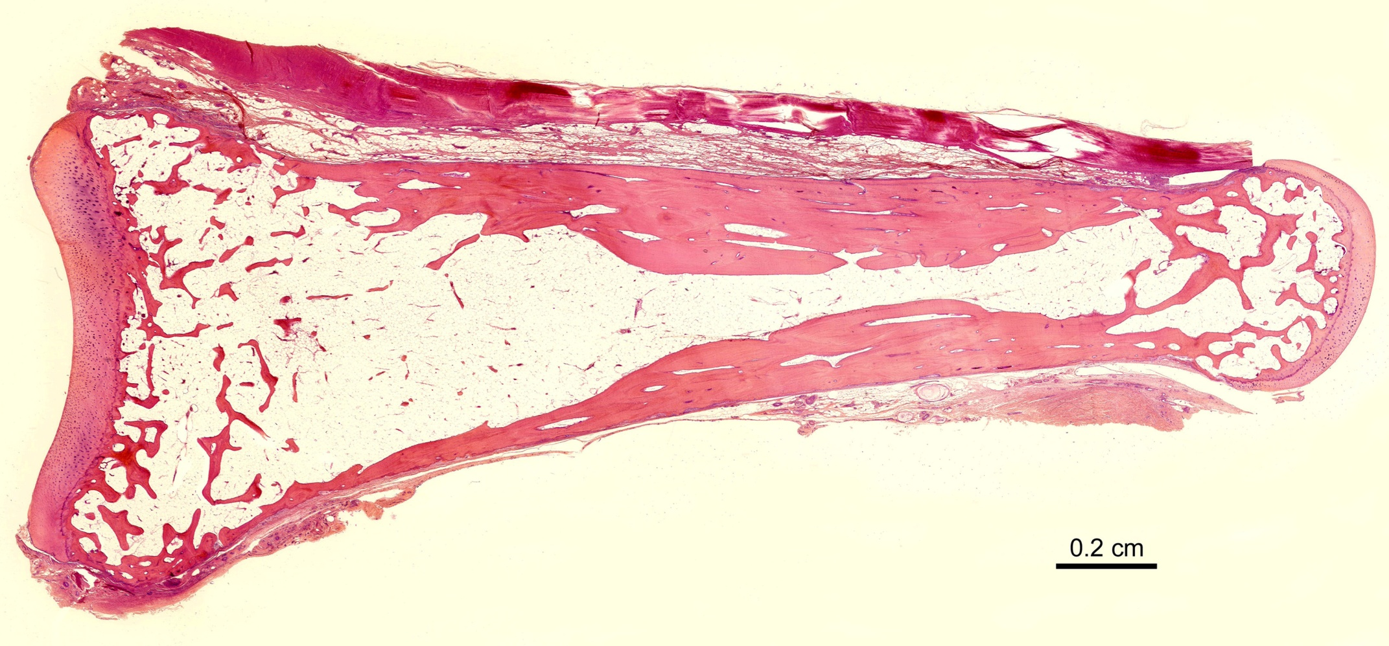
Adult human phalanx
5
2
3
1
4
1
2
3
Key 1 = articular cartilage
2 = cortical bone
3 = trabecular bone
4 = fatty marrow
5 = tendon
t.arnett@ucl.ac.uk

Slide 2
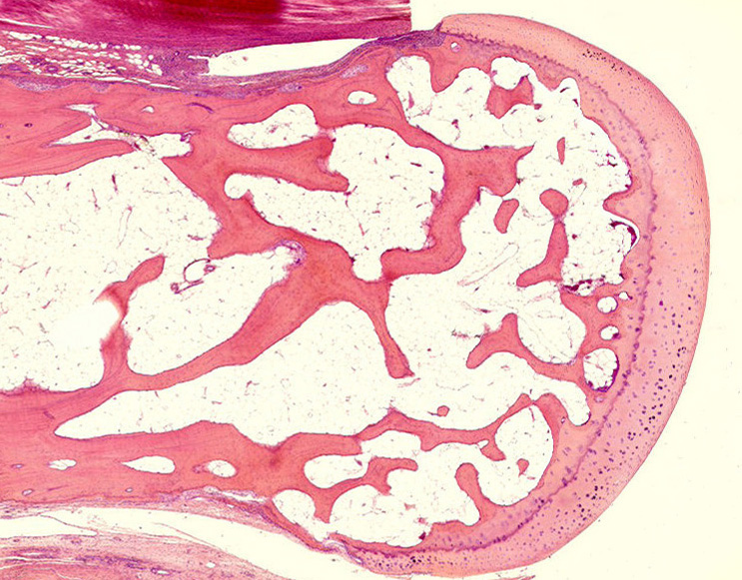
Adult human phalanx

Slide 3
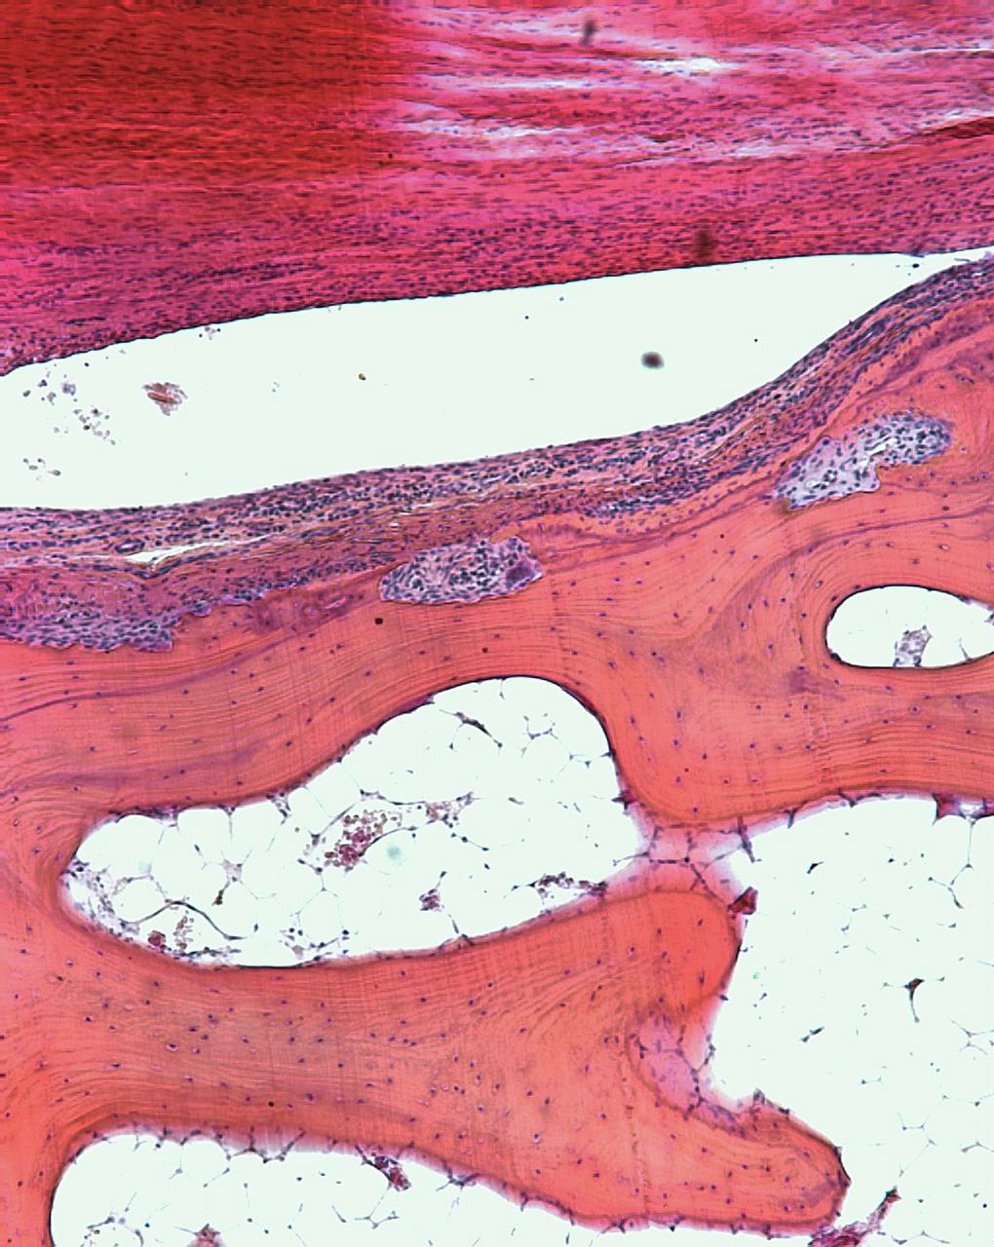
Periosteal remodelling - phalanx

Slide 4
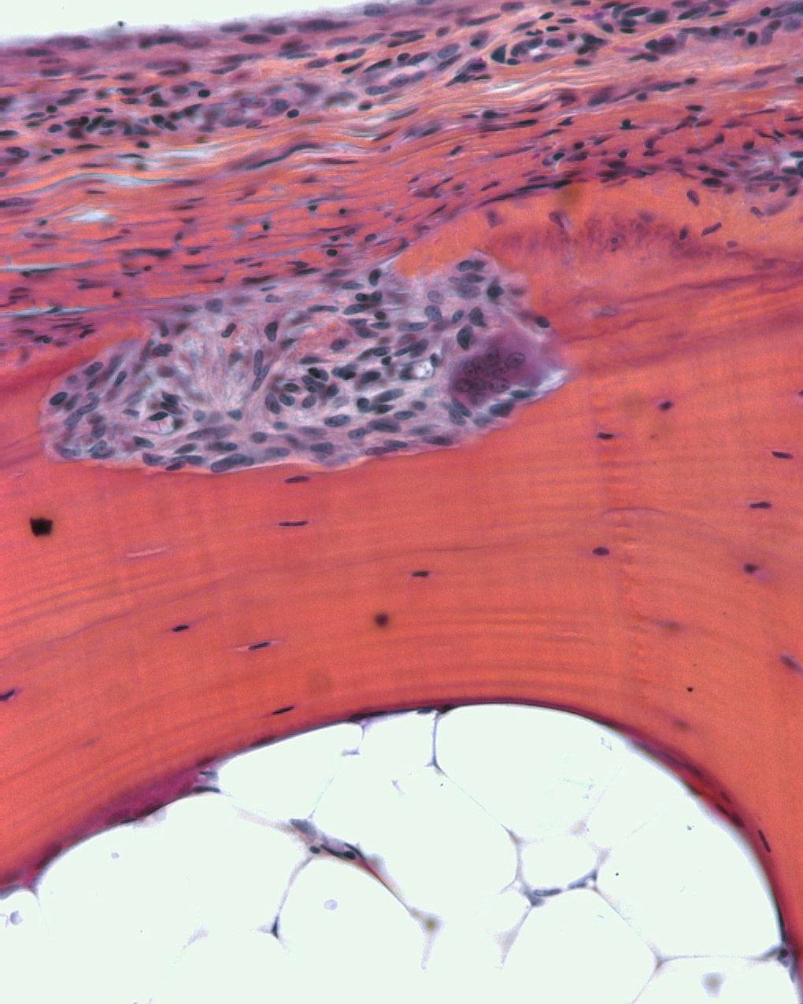
Osteoclast in resorption cavity

