Slide 1
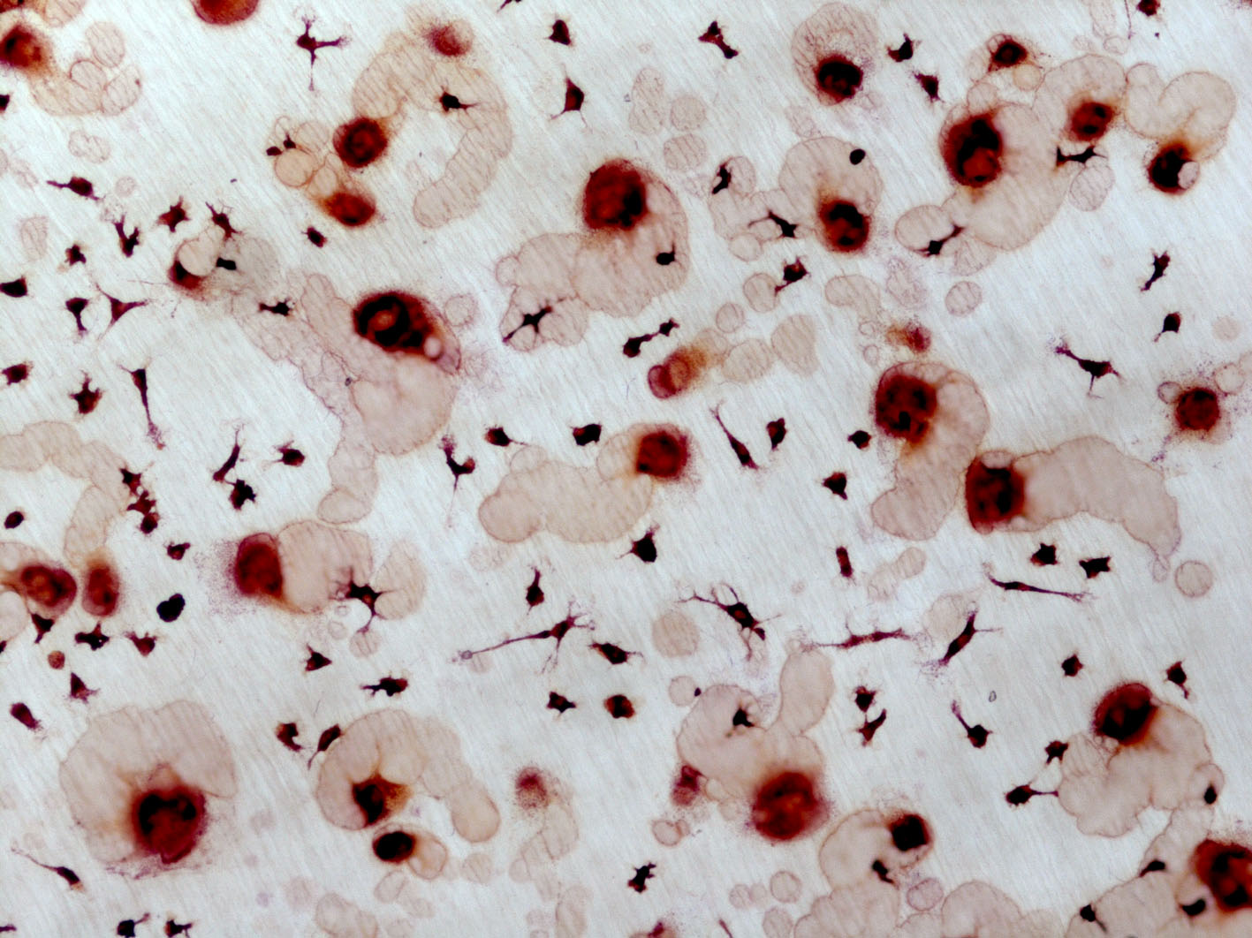
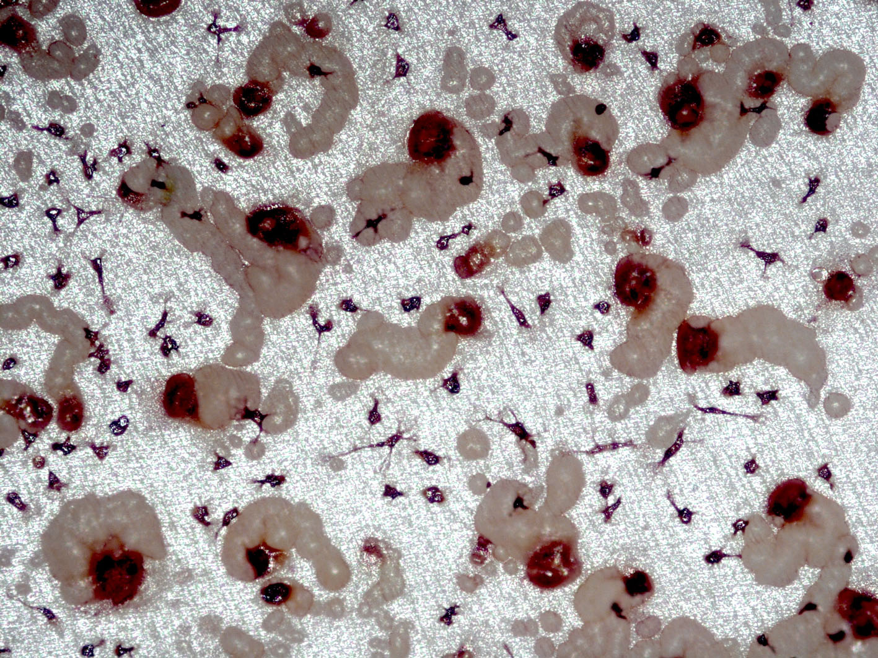
Osteoclast formation from human peripheral
blood mononuclear cells
RANKL + M-CSF 12 days @ pH 7.4
+ 2 days @ pH 7.0
Notes:
1
So what does hypoxia do to osteoclasts?

