Slide 1
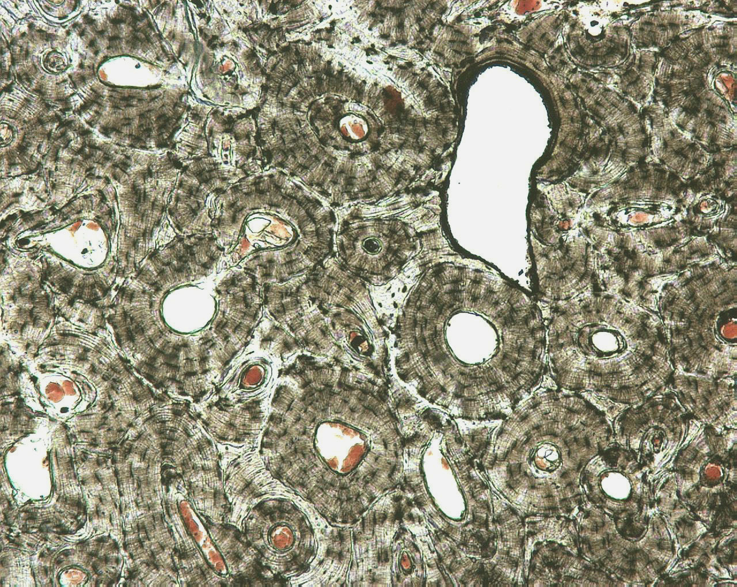
Osteonal (Haversian) systems in human cortical bone

Slide 2
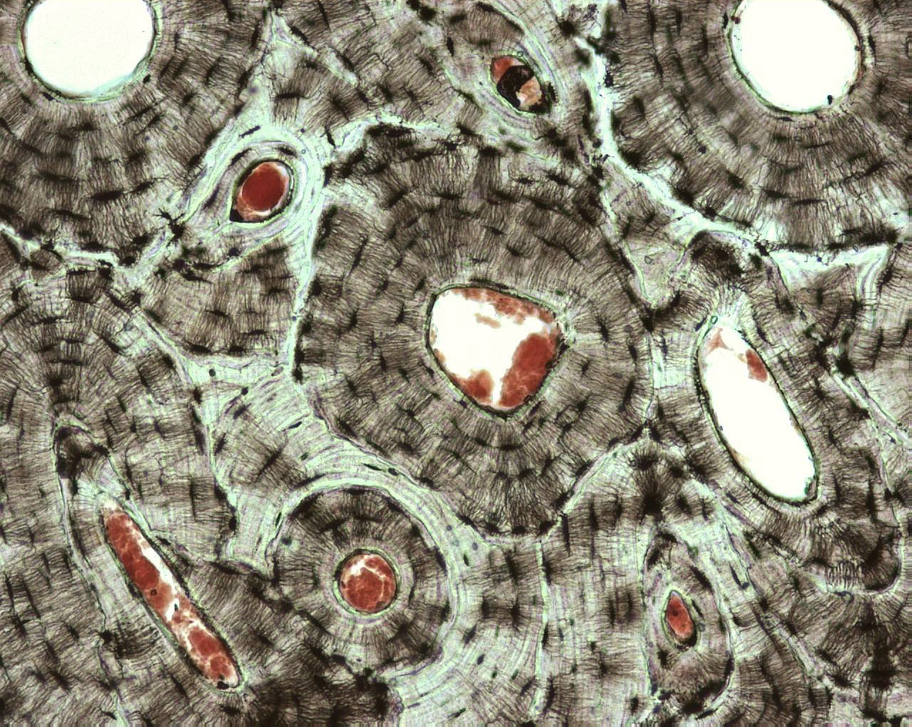
Osteonal systems in human cortical bone

Slide 3
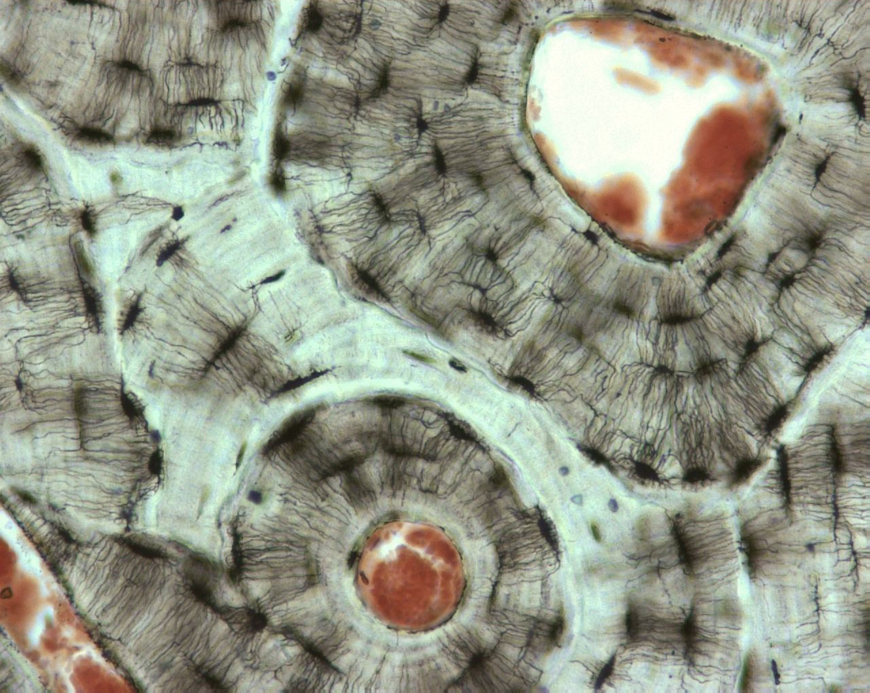
Ostecytes in human cortical bone

