Slide 1
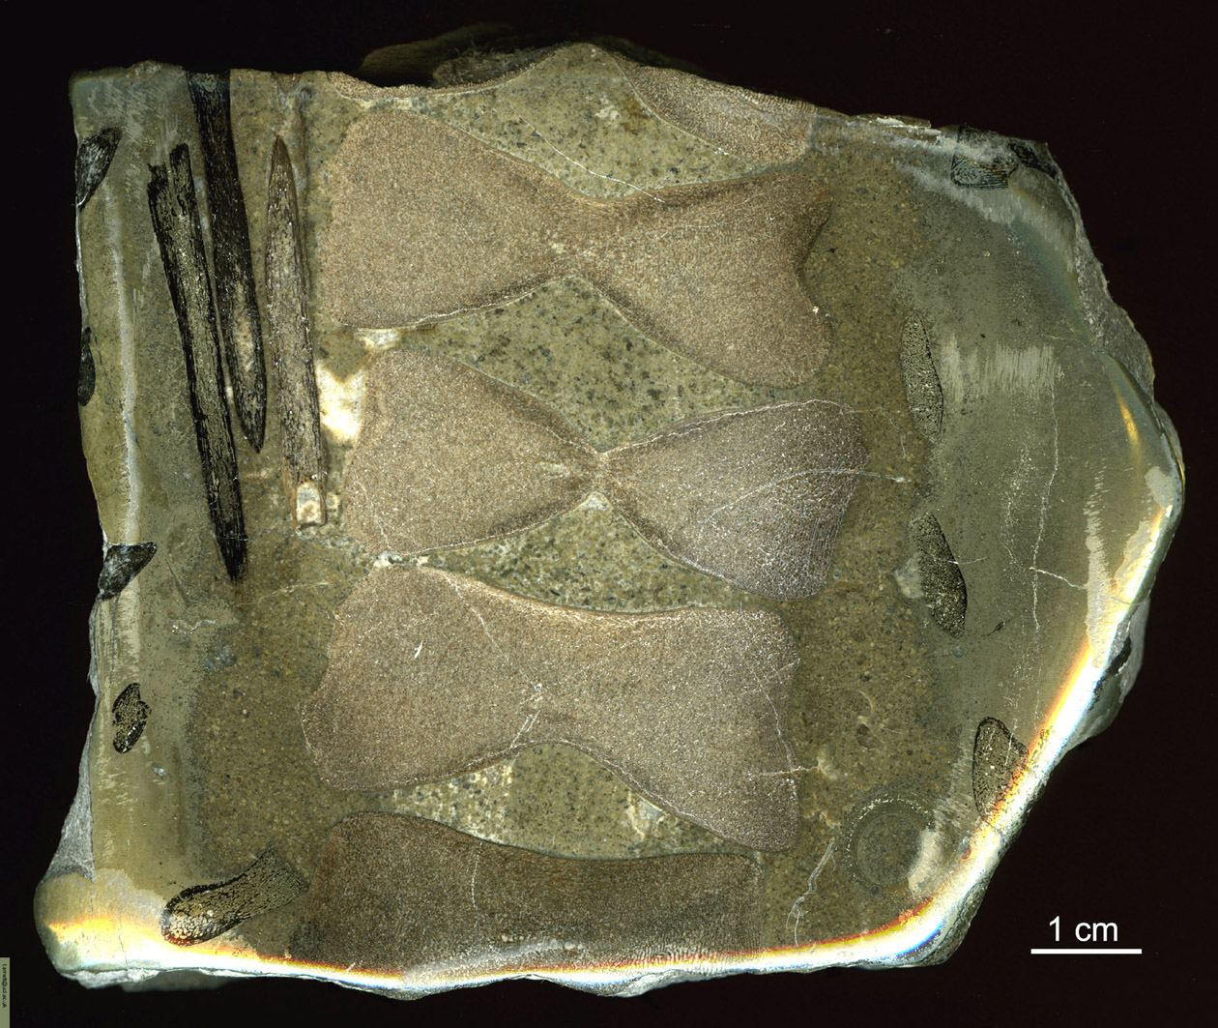
Fossil bone section - vertebral bodies and ribs of ichthyosaur
In pyrite nodule Seatown, Dorset, UK - Jurassic (~190 M yr)

Slide 2
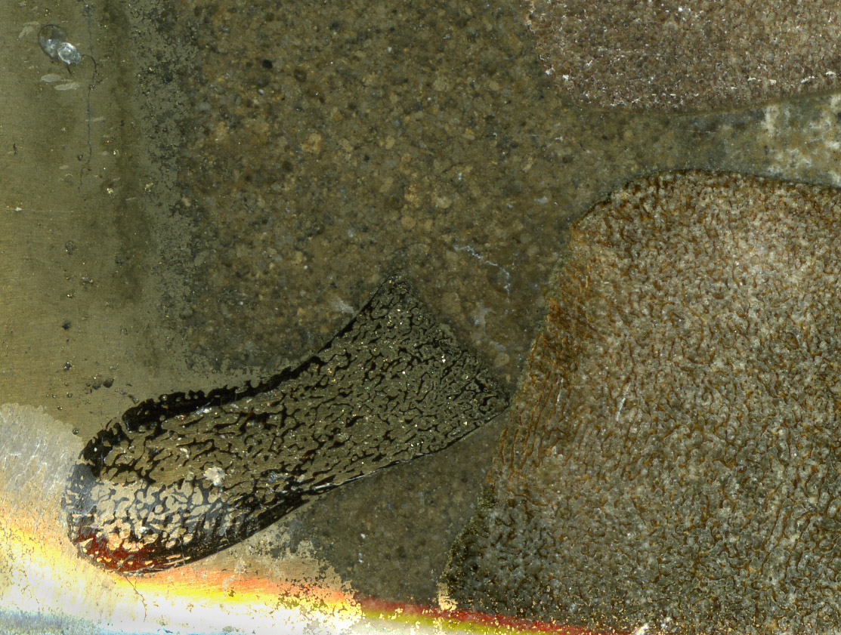
Fossil bone section - vertebral bodies and ribs of ichthyosaur
In pyrite nodule Seatown, Dorset, UK - Jurassic (~190 M yr)
Preservation of trabecular architecture

